Slide 1
ShopEasy!
KESHAV KAANTH 001054298
HARISH SIVAPRAKASH 001378687
BHAGYASHRI GUNDAL 001081806
A shopping and Inventory Management System

Slide 2
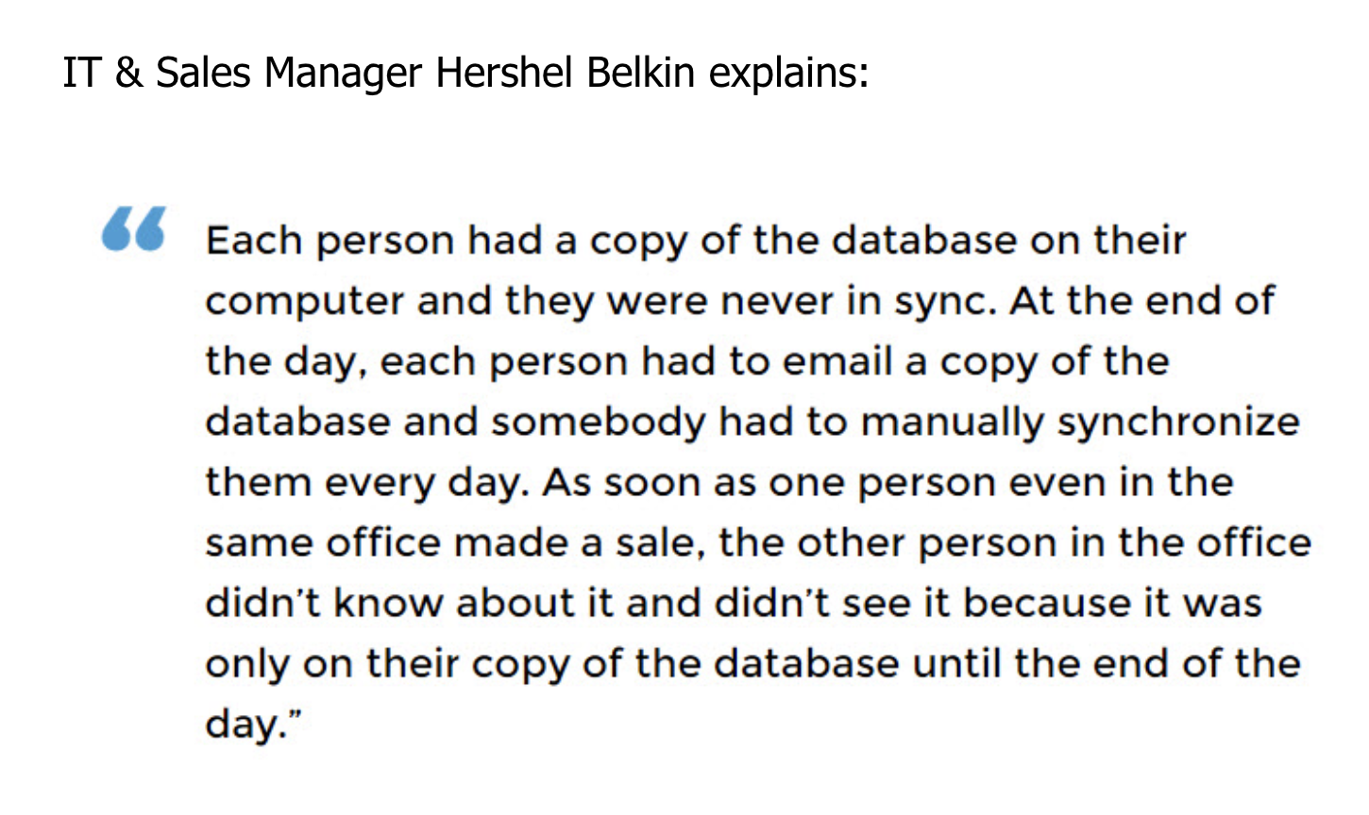
Problem Statement
In current small-scale business there are issues like:
having accurate inventory levels
managing spreadsheets
disconnected workflow
keeping track of components, in-progress, and finished goods

Slide 3

Solve your problem with ShopEasy
Shopeasy a java swing application that allows a registered customer to purchase a variety of products sold by a list of registered vendors.
To have the wholesaler inventory where - the admin and the vendors would have access to update it;
Customers to have the ability to do secure registration and manage their profiles.
To implement secure payment gateway for the customers and vendors.
To allow vendors to add, modify or delete the already posted items.
Inventory management to have the authority to approve and reject requests for new items and have access to control vendor actions.

Slide 4

Approach
Proposed Entities
Enterprises
Wholesaler
Marketplace
Delivery
Organizations
Customer
Vendor
Admin
Delivery
Payment
Inventory

Slide 5
Use Cases

Slide 6
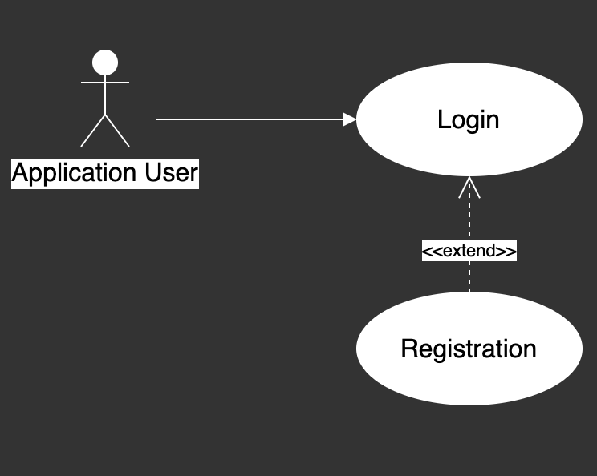
Login

Slide 7
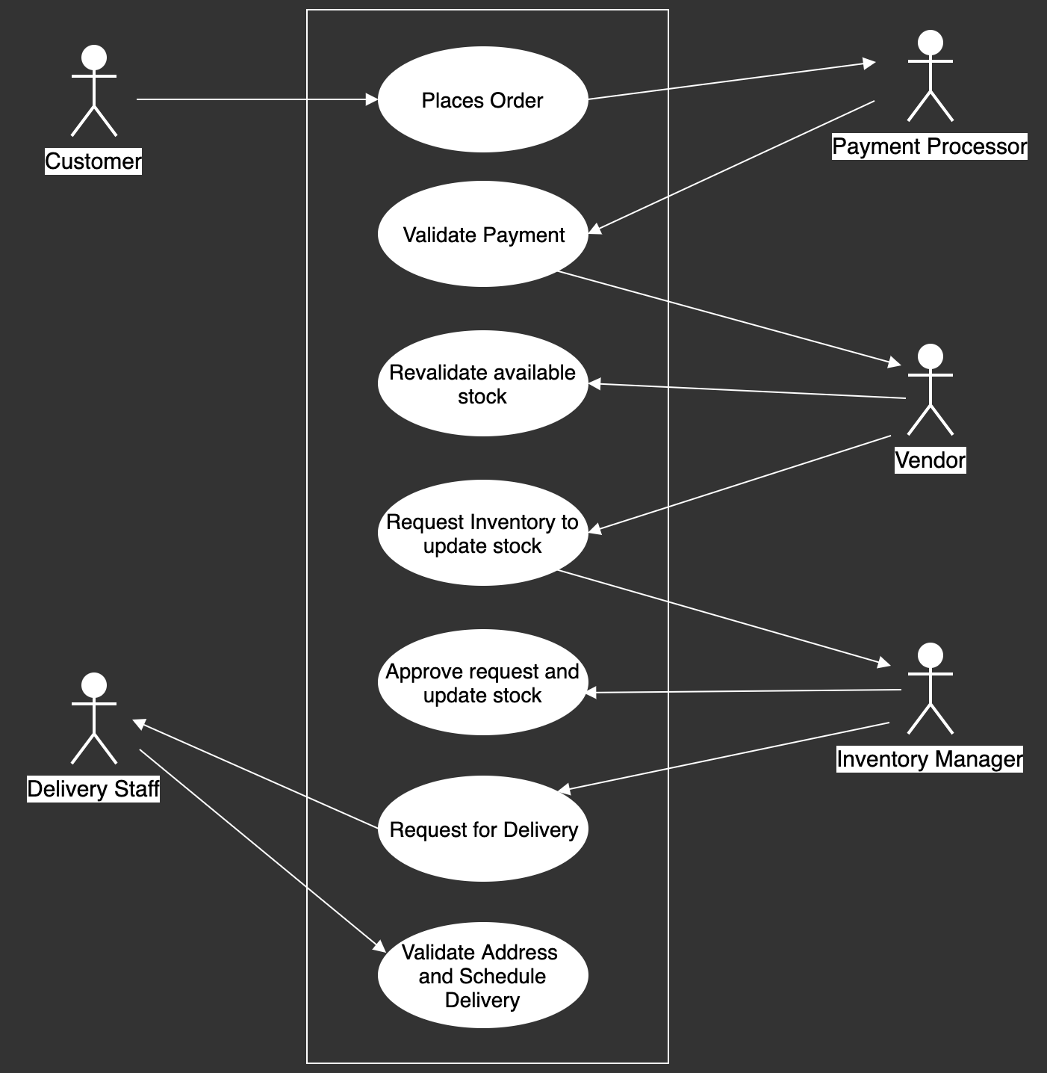
System Use case Diagram

Slide 8
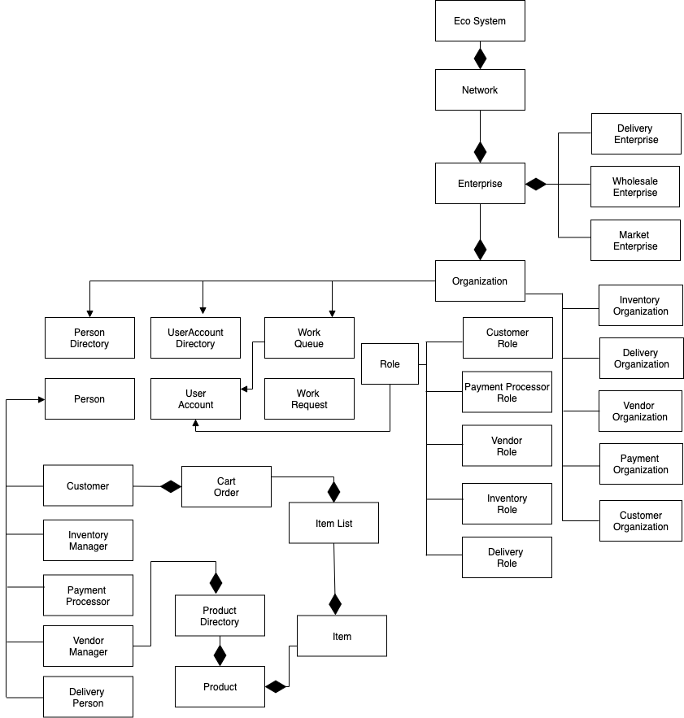
Object Model

Slide 9

Application GUI with Workflow

Slide 10
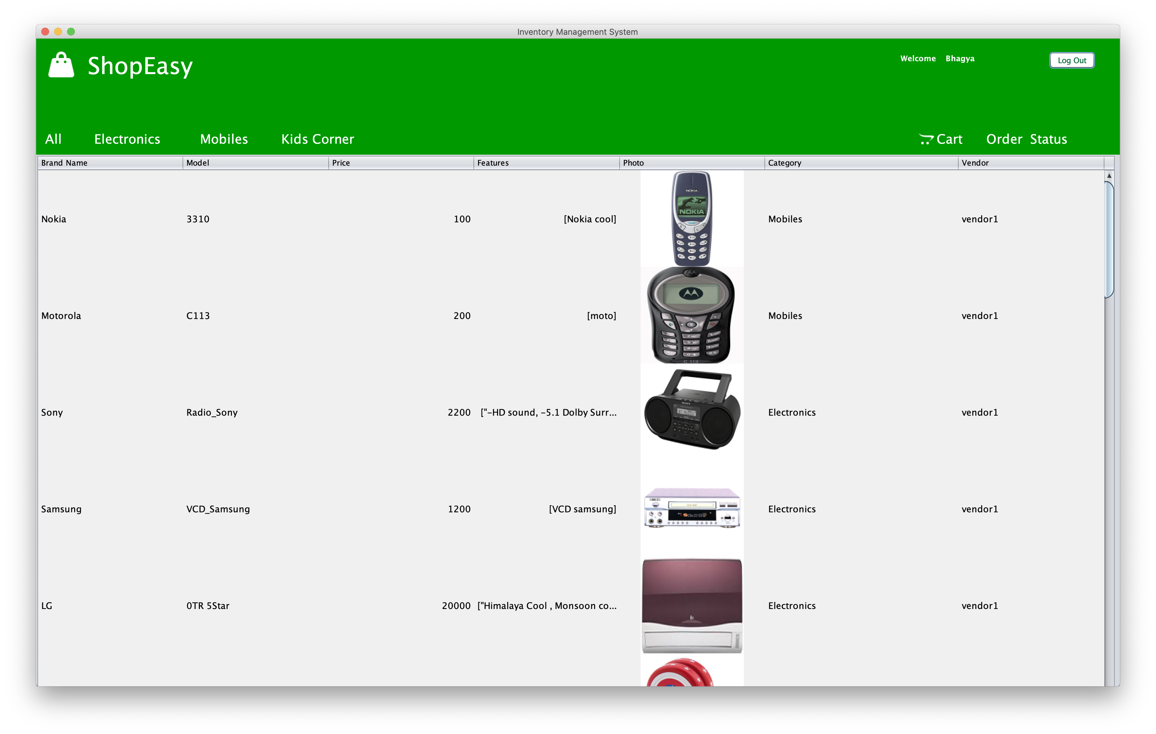
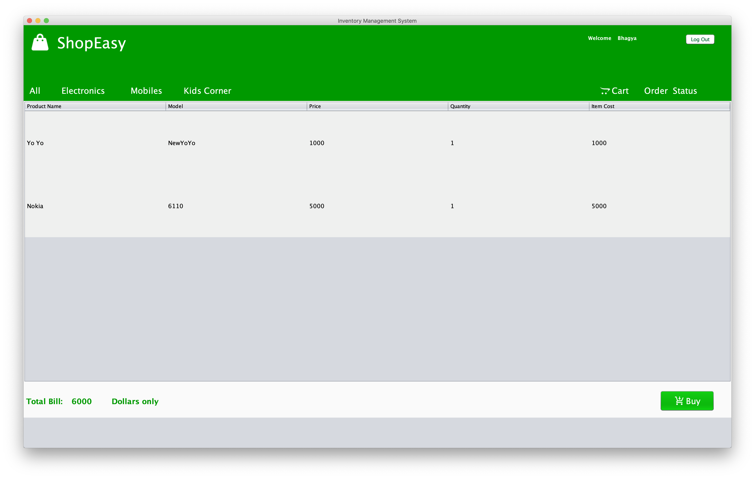
2. Customer will add products to the cart and procced towards payment
Workflow I
1. Upon customer login, all the products in the Inventory will be loaded.

Slide 11
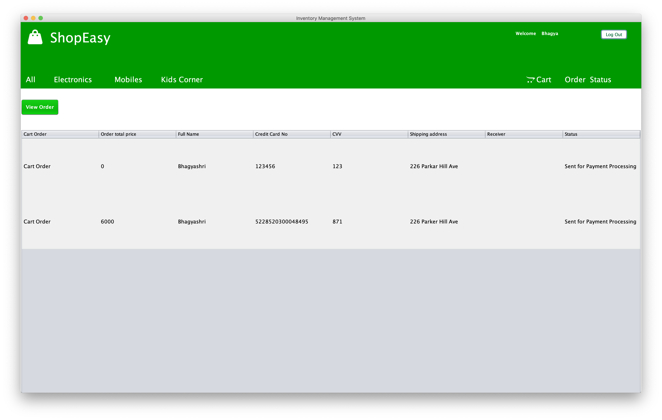
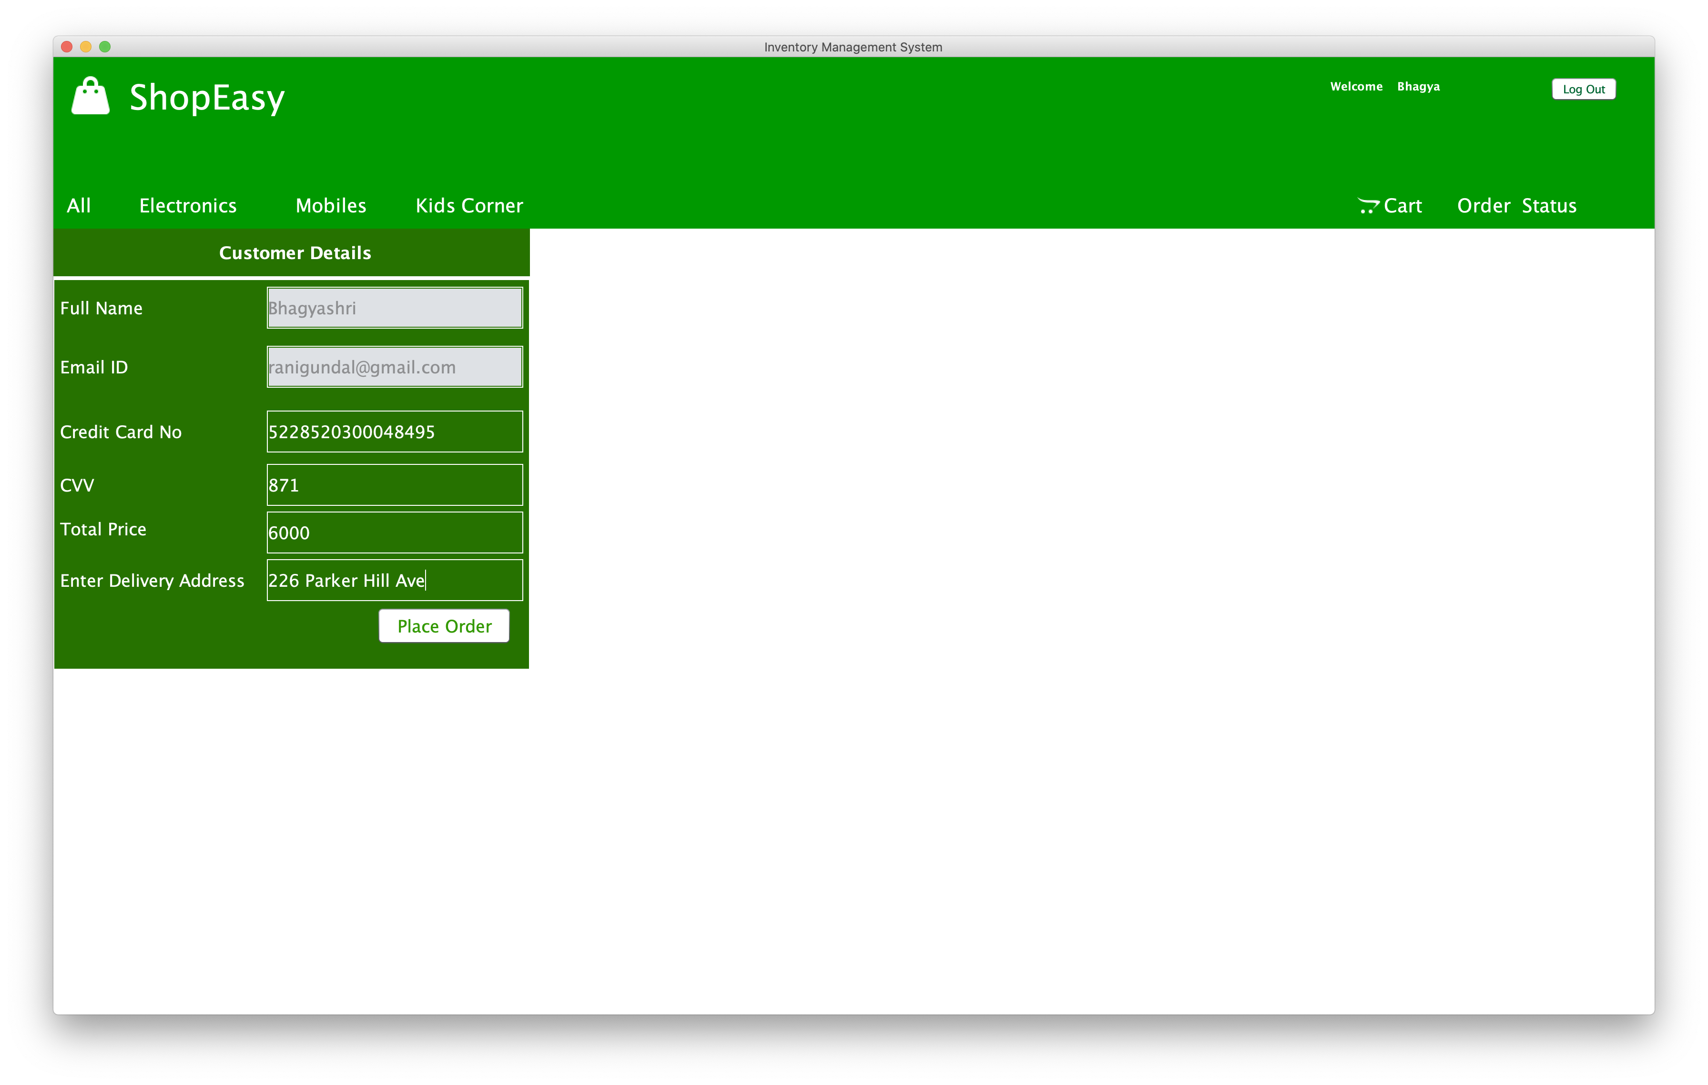
3. Enter correct details of credit card,
CVV and shipping address to place order.
4. Wait for payment processing and check for updates via email.

Slide 12
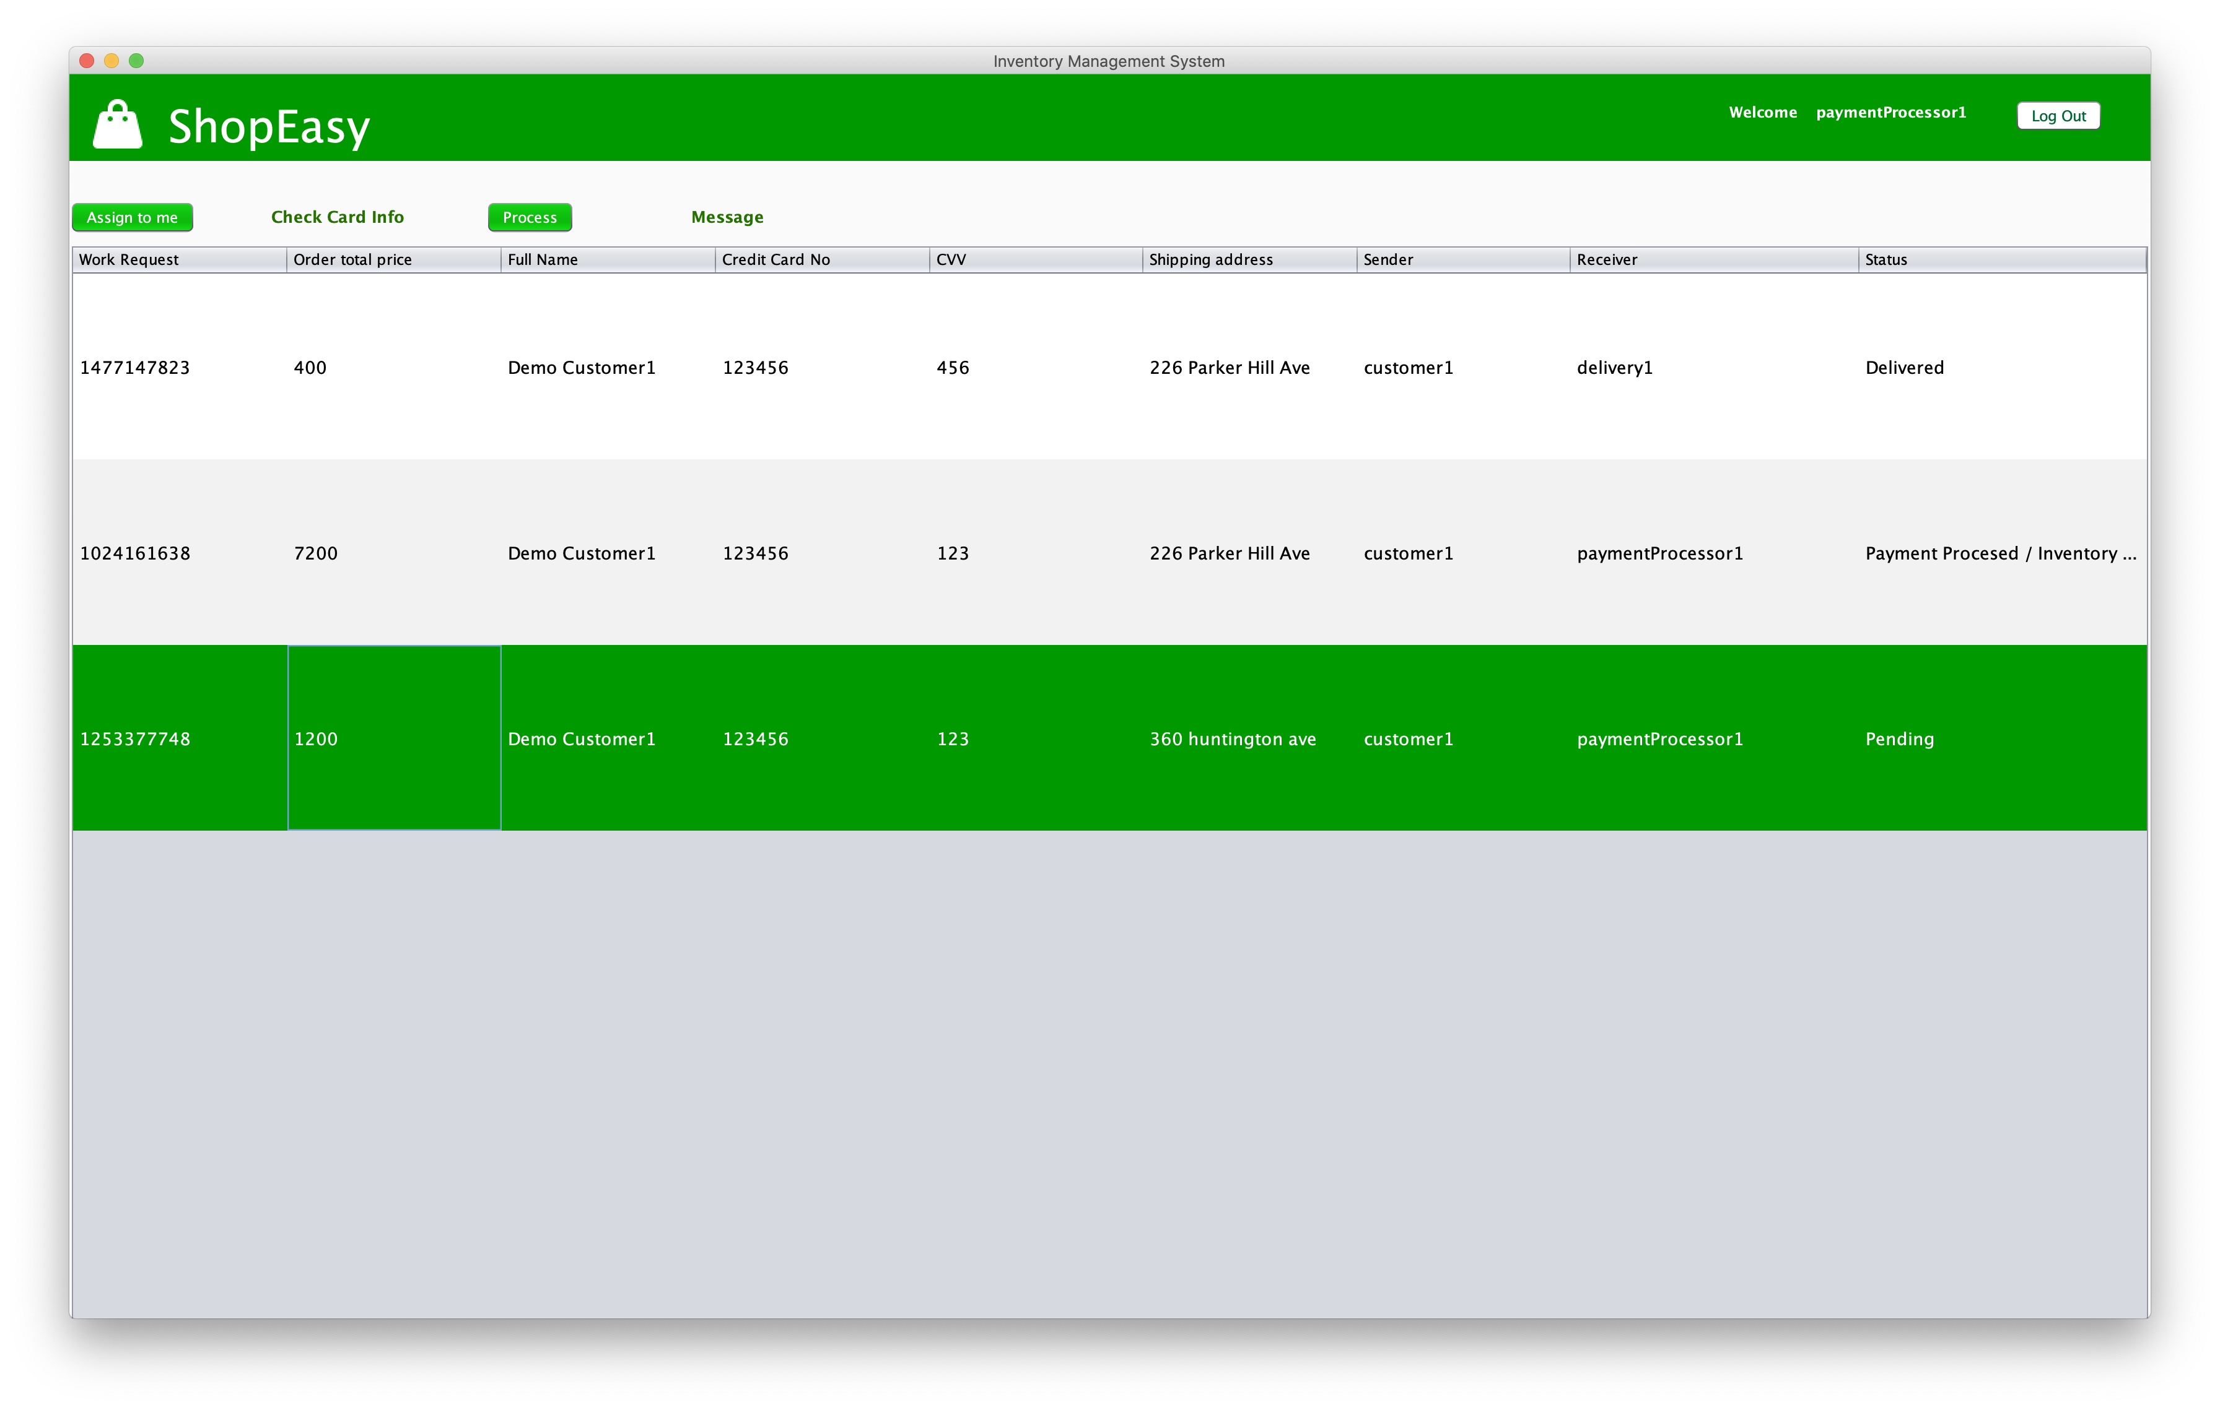
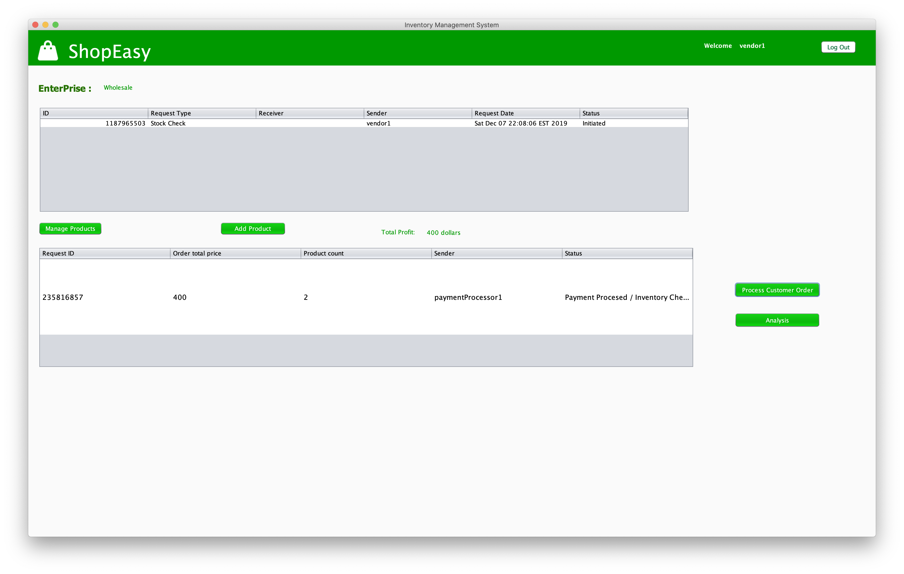
2. Upon successful payment confirmation, vendor organization sends request to inventory to check and update stock, ship the product to delivery organization.
Workflow II
1. Payment Organization will validate Credit Card and CVV number for customer.

Slide 13
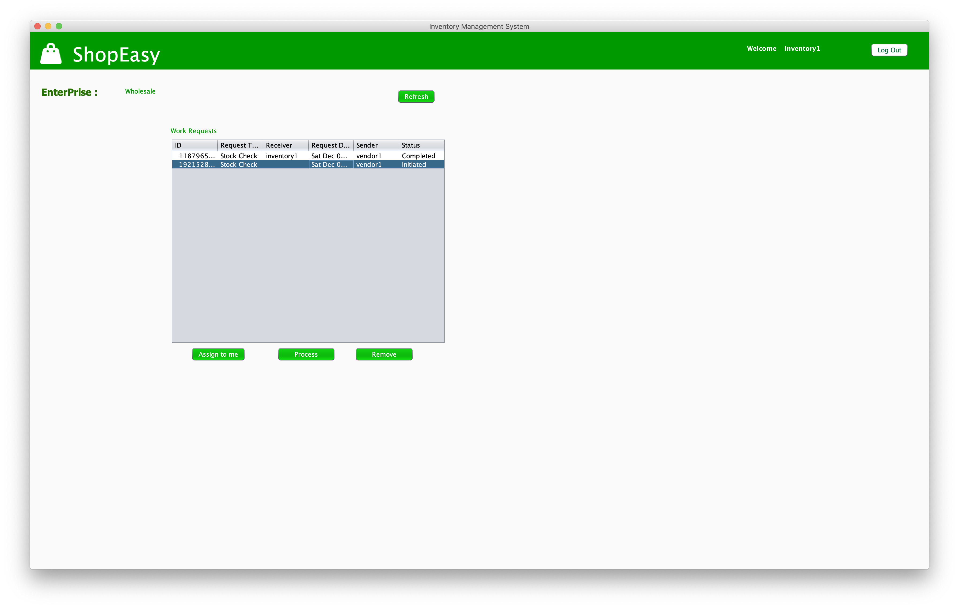
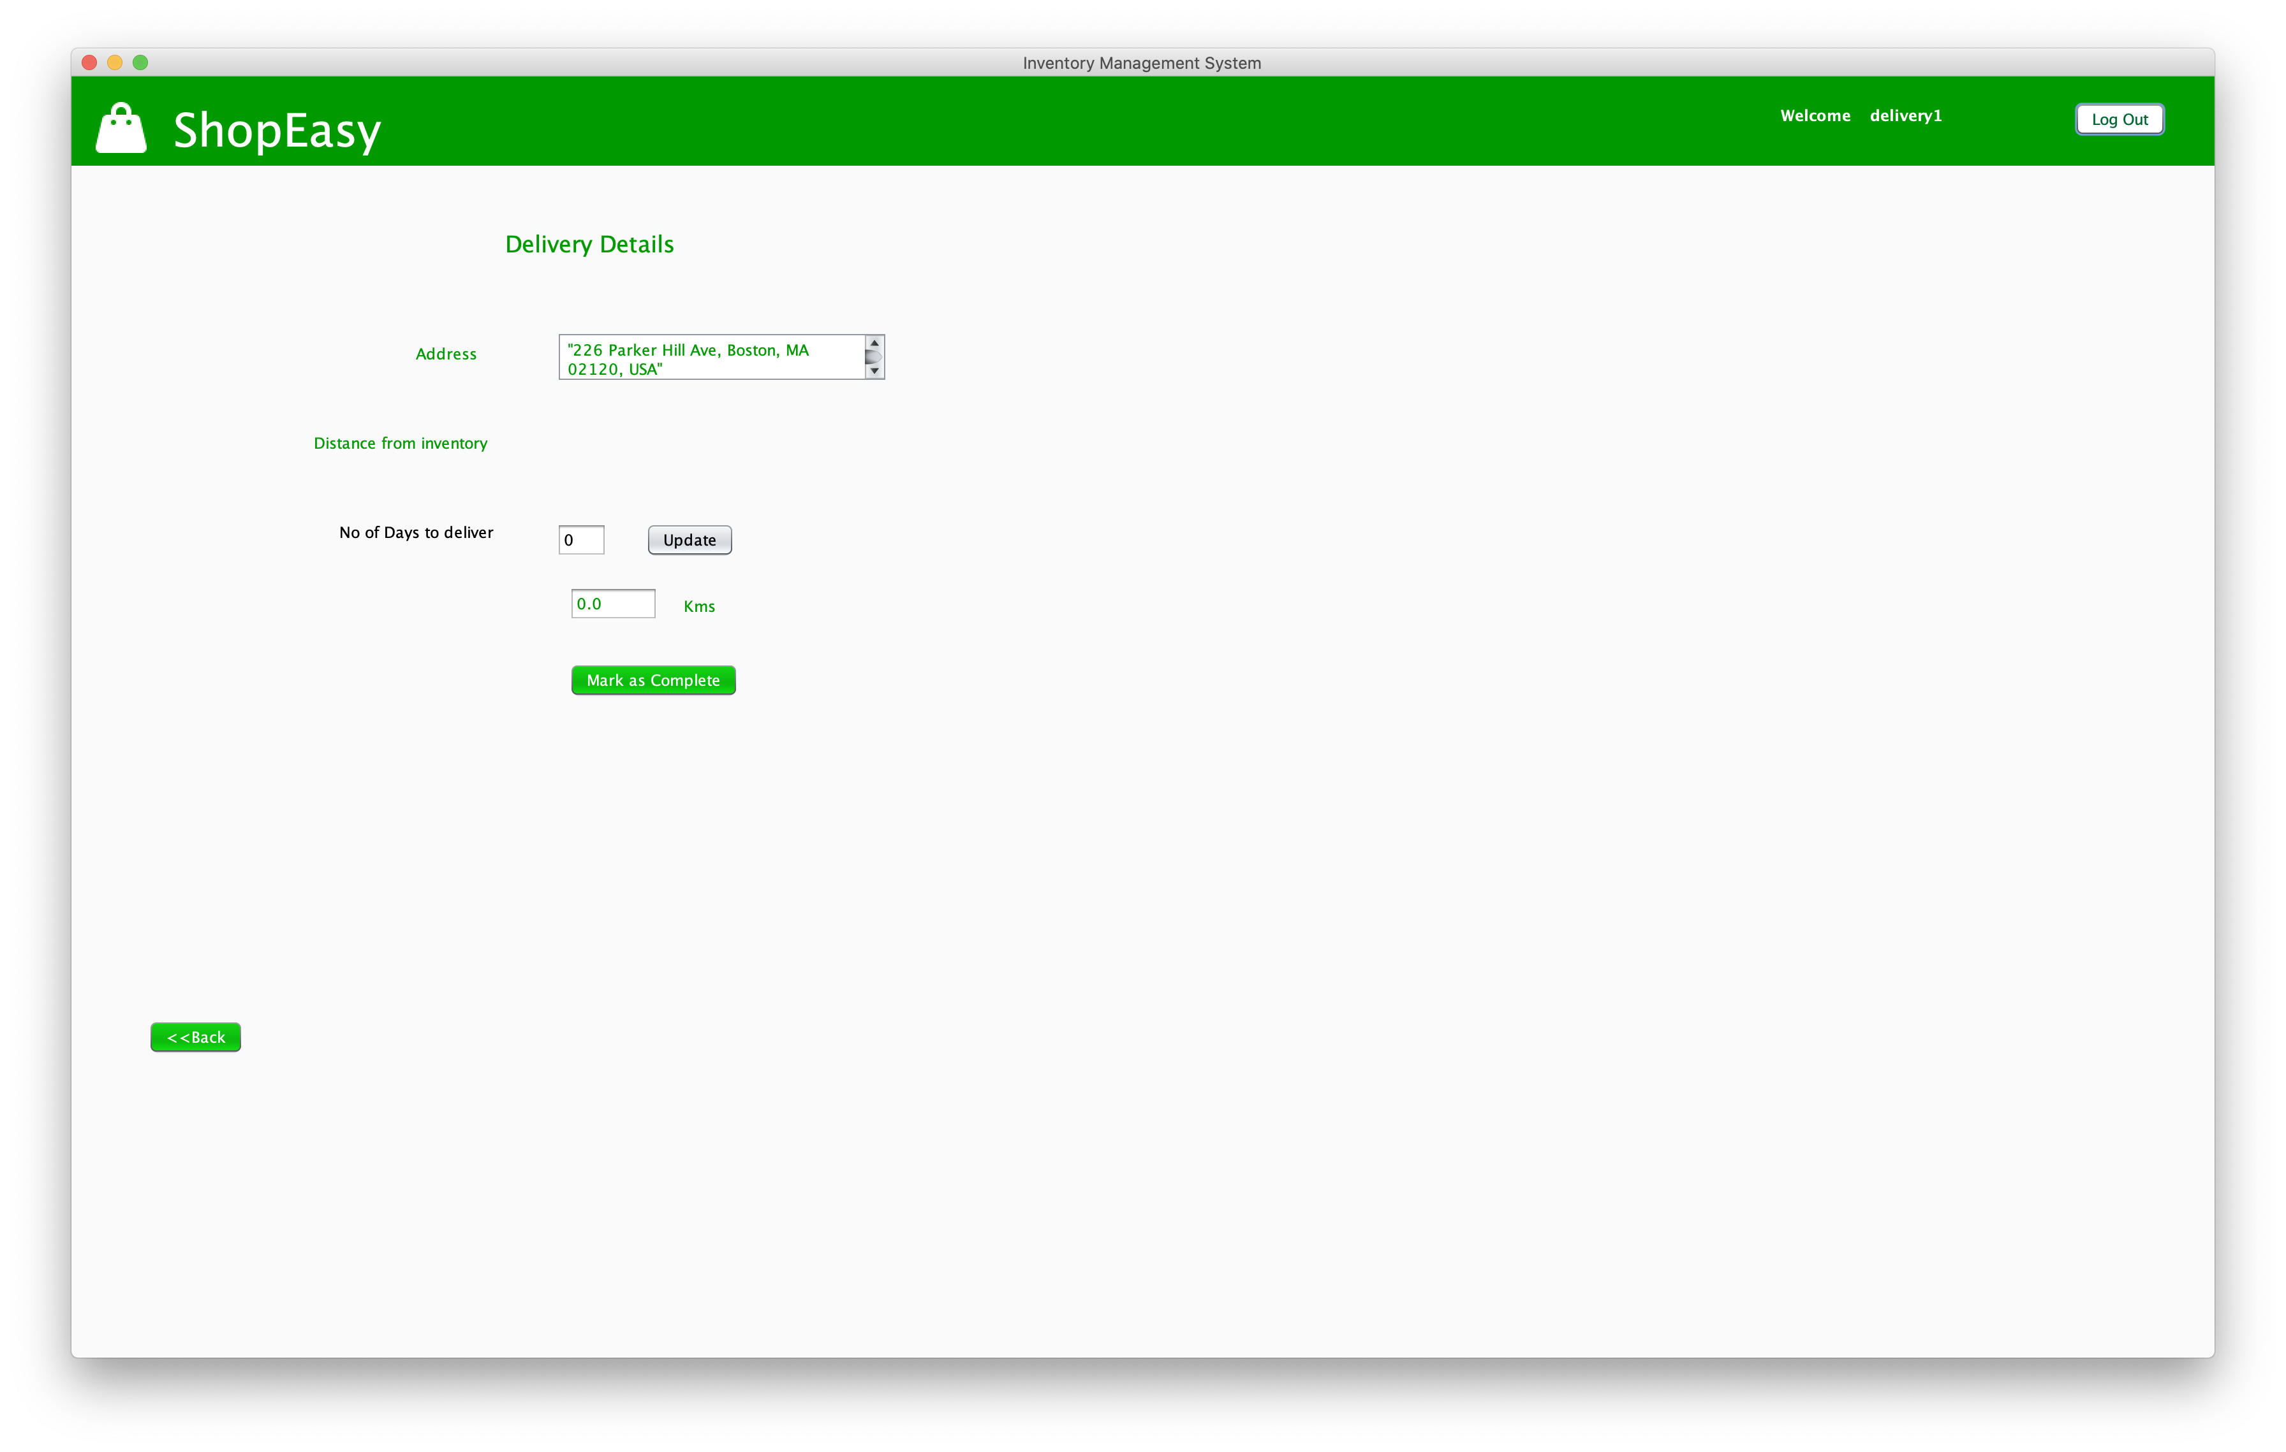
Workflow III
1. Inventory Organization will update the stock and approve the product to be delivered by delivery organization.
2. Delivery Organization will validate the shipping address of the customer and take product out for delivery and update no of days required for delivery.

Slide 14
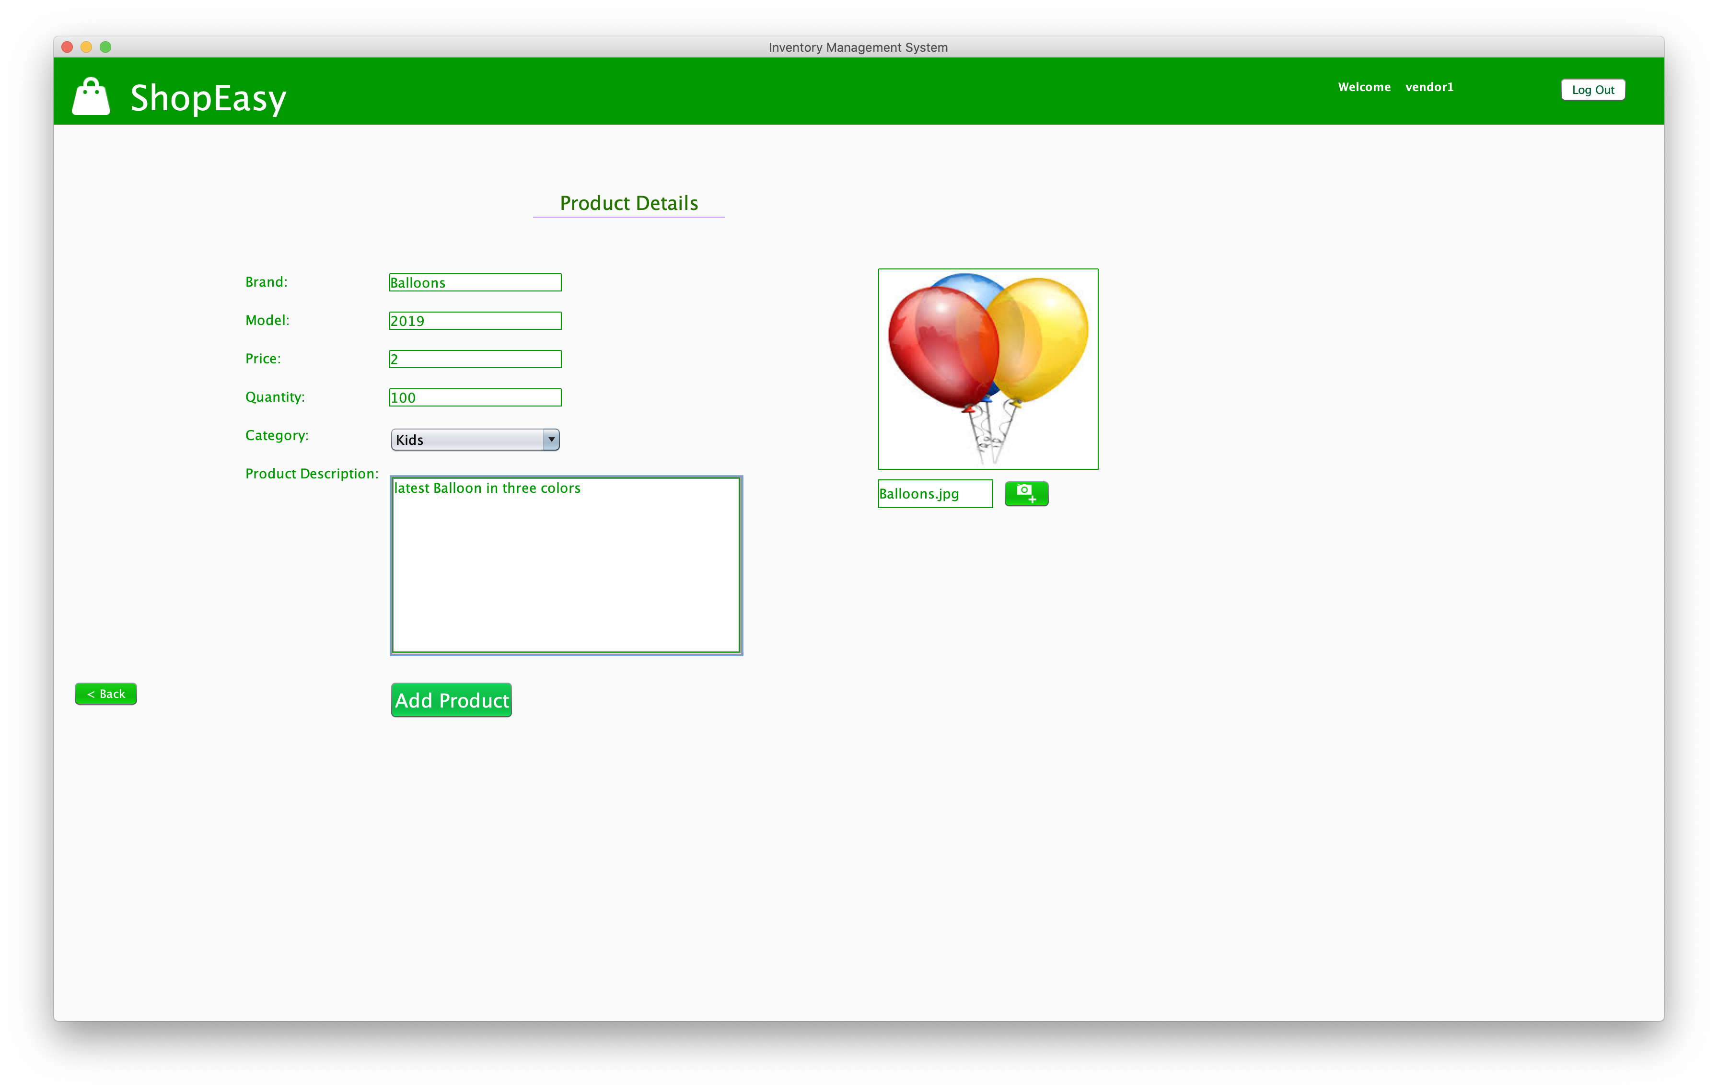
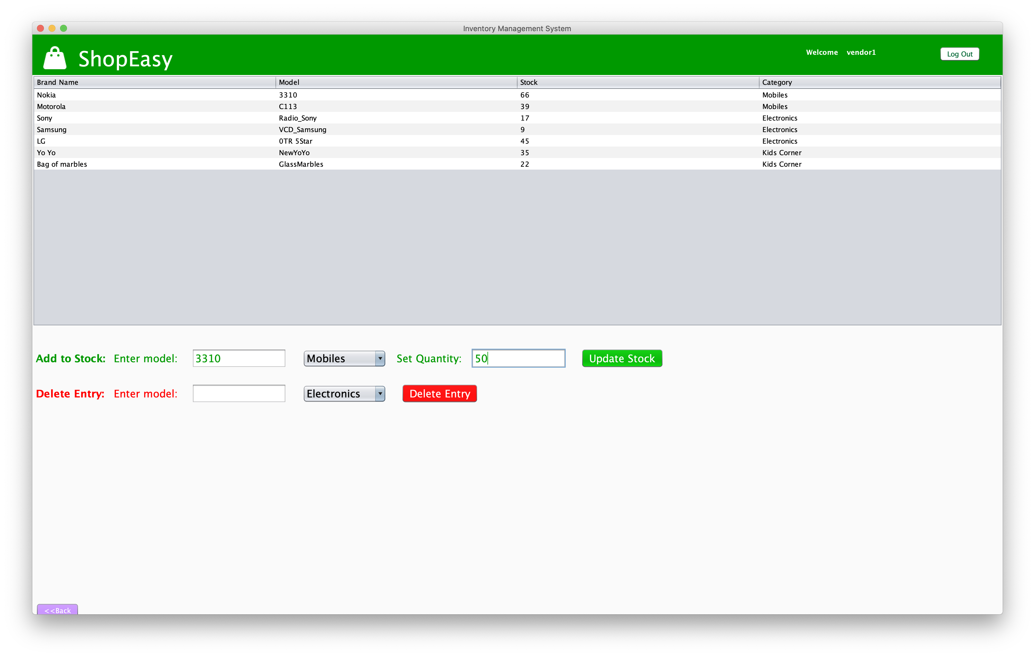
Workflow 4
Adding new products to inventory
Delete or update products from inventory

Slide 15

THANK YOU

